Slide 1


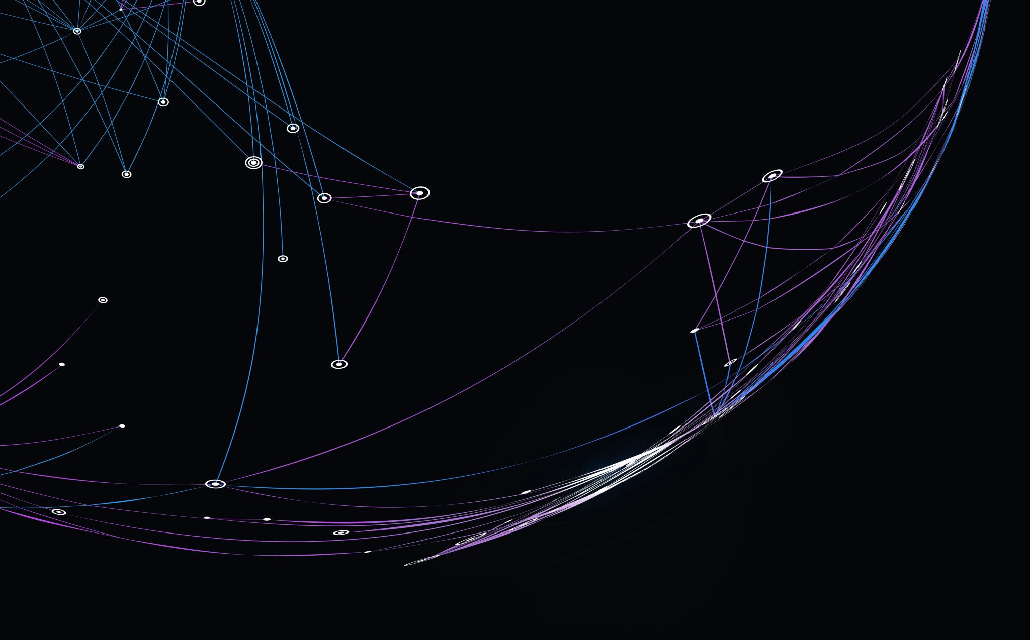
Bournemouth University – Blockchain & Cryptocurrency Hackathon
Blocksmiths & Cryptocrafters
“ Where Innovation Meets Immutable Visions “
Wallet SECURITY & Transaction Validation
“Suspethious”
“A Tool that detects phishing & validates transaction intent before signing”

Slide 2
Bournemouth University – Blockchain & Cryptocurrency Hackathon
Blocksmiths & Cryptocrafters
“ Where Innovation Meets Immutable Visions “
Team Members:
Samuel Mariwa – S5721725
Vikram Srinivasan – s5733575
Ronish TandEL – S5641897
ADWOA YEBOAH DANQUAH – S5612692

Slide 3
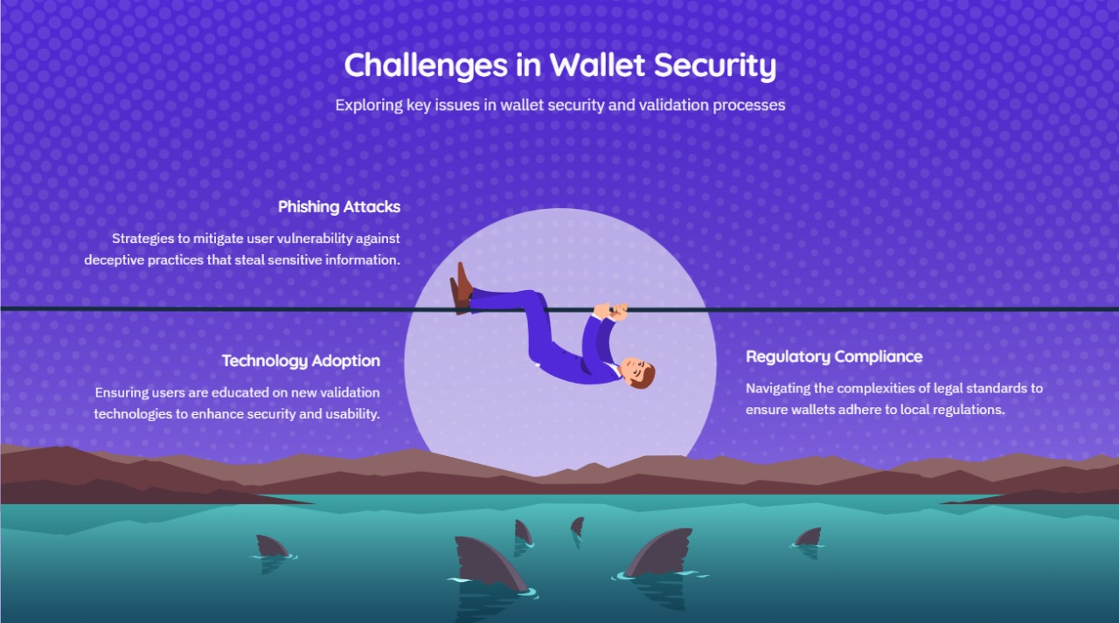
Bournemouth University – Blockchain & Cryptocurrency Hackathon
Blockmiths & Cryptocrafters
“ Where Innovation Meets Immutable Visions “

Slide 4
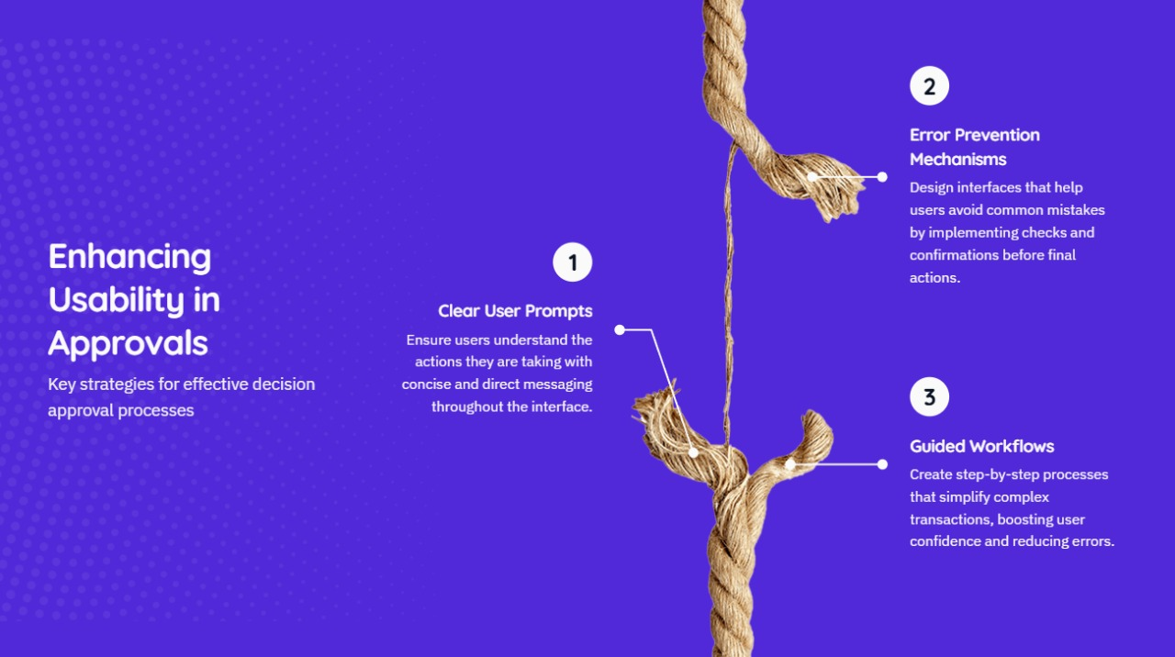
Bournemouth University – Blockchain & Cryptocurrency Hackathon
Blockmiths & Cryptocrafters
“ Where Innovation Meets Immutable Visions “

Slide 5
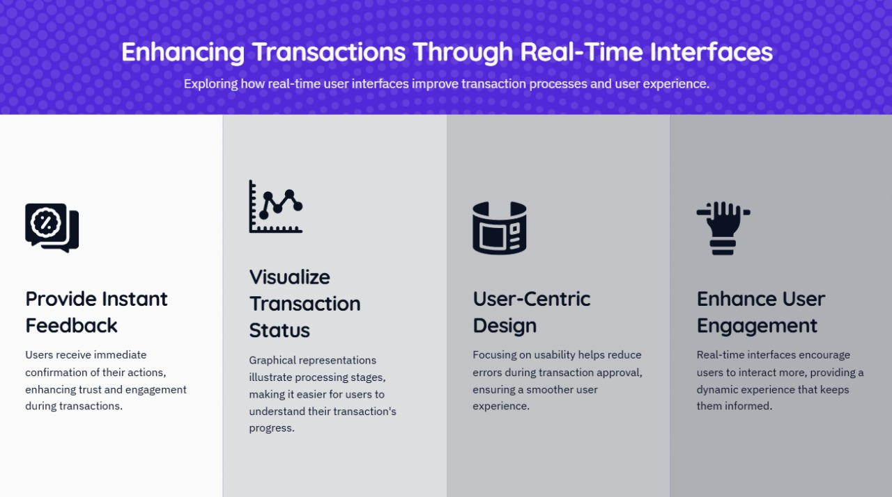
Bournemouth University – Blockchain & Cryptocurrency Hackathon
Blockmiths & Cryptocrafters
“ Where Innovation Meets Immutable Visions “

Slide 6
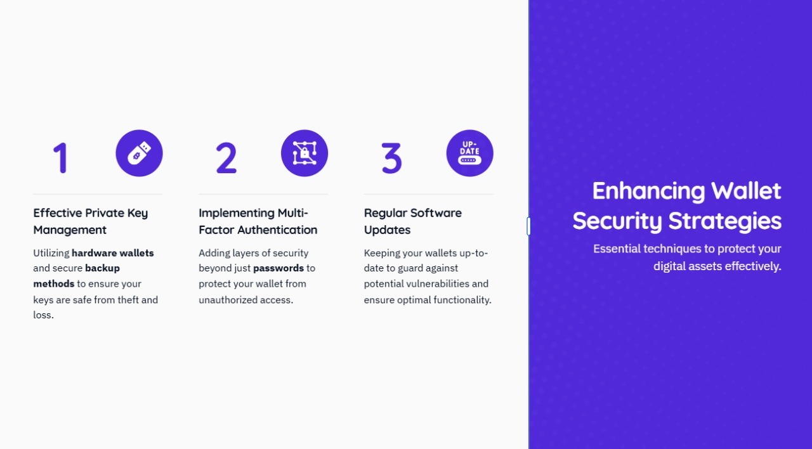
Bournemouth University – Blockchain & Cryptocurrency Hackathon
Blockmiths & Cryptocrafters
“ Where Innovation Meets Immutable Visions “

Slide 7
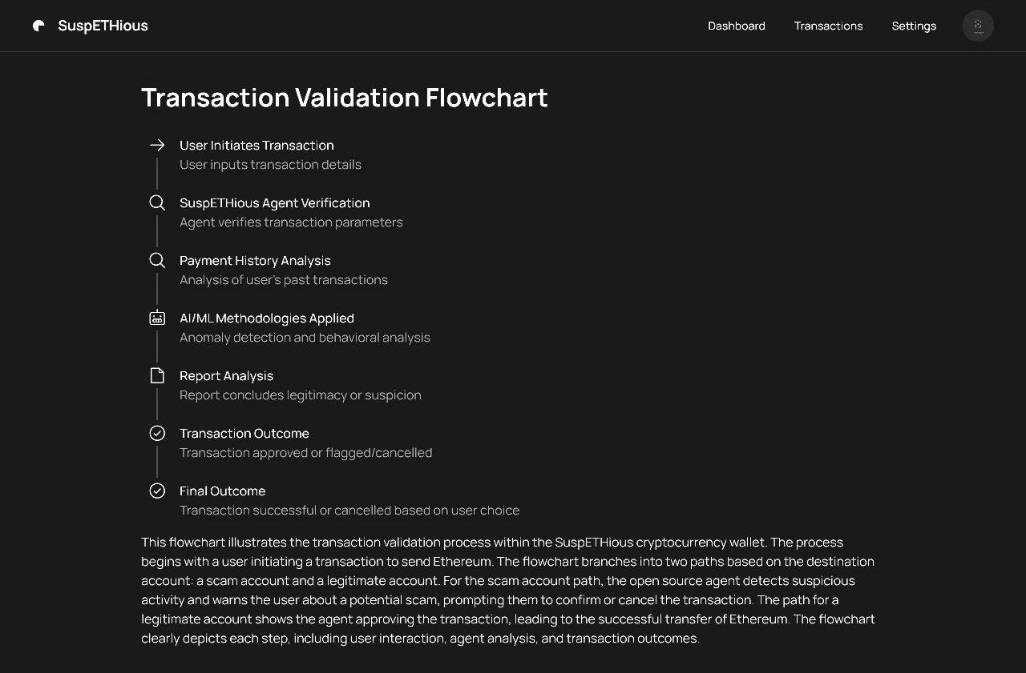
Bournemouth University – Blockchain & Cryptocurrency Hackathon
Blockmiths & Cryptocrafters
“ Where Innovation Meets Immutable Visions “

Slide 8
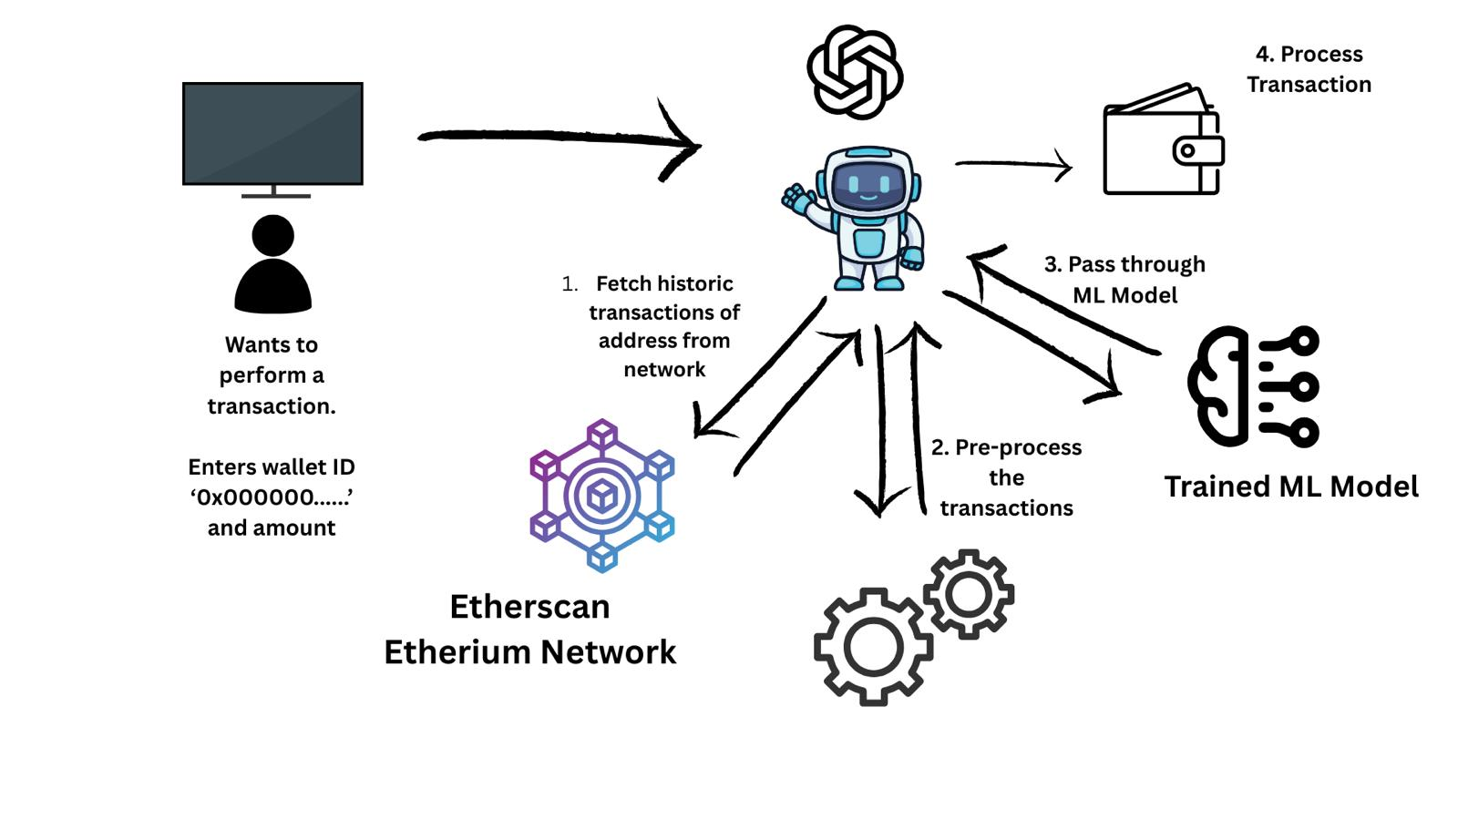
Bournemouth University – Blockchain & Cryptocurrency Hackathon
Blockmiths & Cryptocrafters
“ Where Innovation Meets Immutable Visions “

